Slide 1
Statistics
Parameswari Ettiappan

Slide 2
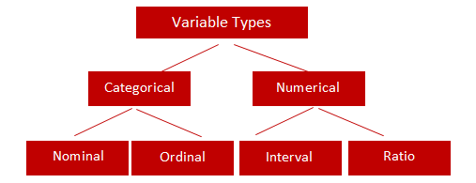
Types of Variables

Slide 3
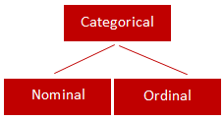
Categorical
Qualitative data are often termed categorical data.
Data that can be added into categories according to their characteristics.
Examples are gender, social class and blood types

Slide 4
Nominal Variable (Unordered list)
A variable that has two or more categories, without any implied ordering.
Examples : Gender - Male, Female
Marital Status - Unmarried, Married, Divorcee
State - New Delhi, Haryana, Illinois, Michigan

Slide 5
Ordinal Variable (Ordered list)
A variable that has two or more categories, with clear ordering. Examples :
Scale - Strongly Disagree, Disagree, Neutral, Agree, Strongly Agree
Rating - Very low, Low, Medium, Great, Very great

Slide 6
Interval
An interval variable is similar to an ordinal variable, except that the intervals between the values of the interval variable are equally spaced.
In other words, it has order and equal intervals.
Examples :
Temperature in Celsius - Temperature of 30°C is higher than 20°C, and temperature of 20°C is higher than 10°C. The size of these intervals is the same.
Annual Income in Dollars - Three people who make $5,000, $10,000 and $15,000. The second person makes $5,000 more than the first person and $5,000 less than the third person, and the size of these intervals is the same.

Slide 7
Ratio
It is interval data with a natural zero point.
When the variable equals 0.0, there is none of that variable. Examples :
Height
Weight
Temperature in Kelvin - It is a ratio variable, as 0.0 Kelvin really does mean 'no temperature.

Slide 8
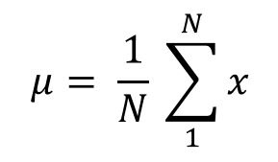
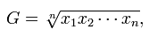
Central Location
(a) Arithmetic Mean
Of these “averages,” the most common and familiar is the arithmetic mean, defined by
(b) Geometric Mean
The geometric mean is defined as the nth root of the product of n observations:

Slide 9
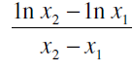
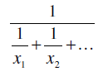
Central Location
© Logarithmic Mean
The logarithmic mean of two numbers is given by the difference of the natural logarithms of the two numbers, divided by the difference between the numbers.
It is used particularly in heat transfer and mass transfer.
(d) Harmonic Mean
The harmonic mean involves inverses—i.e., one divided by each of the quantities.
The harmonic mean is the inverse of the arithmetic mean of all the inverses.

Slide 10
Median
If all the items with which we are concerned are sorted in order of increasing magnitude (size), from the smallest to the largest, then the median is the middle item.
Consider the five items: 12, 13, 21, 27, 31. Then 21 is the median.
If the number of items is even, the median is given by the arithmetic mean of the two middle items. Consider the six items: 12, 13, 21, 27, 31, 33.
The median is (21 + 27) / 2 = 24.

Slide 11
Mode
If the frequency varies from one item to another, the mode is the value which appears most frequently.
In the case of continuous variables the frequency depends upon how many digits are quoted, so the mode is more usefully considered as the midpoint of the class with the largest frequency.

Slide 12
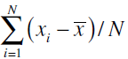
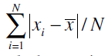
Variability or Spread of the Data
Mean Deviation from the Mean
The mean deviation from the mean, defined as –
Mean Absolute Deviation from the Mean

Slide 13
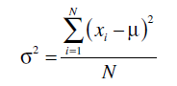
Variability or Spread of the Data
Variance
Since squares of both positive and negative real numbers are always positive, the variance is always positive.

Slide 14
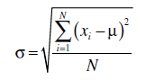
Variability or Spread of the Data
Standard Deviation

Slide 15
Quartiles, Deciles, Percentiles, and Quantiles
Quartiles, deciles, and percentiles divide a frequency distribution into a number of parts containing equal frequencies.
Quartiles divide the range of values into four parts, each containing one quarter of the values.
Percentiles divide into a hundred parts, each containing one hundredth of the total frequency.
Quantile divides a frequency distribution into parts containing stated proportions of a distribution.

Slide 16
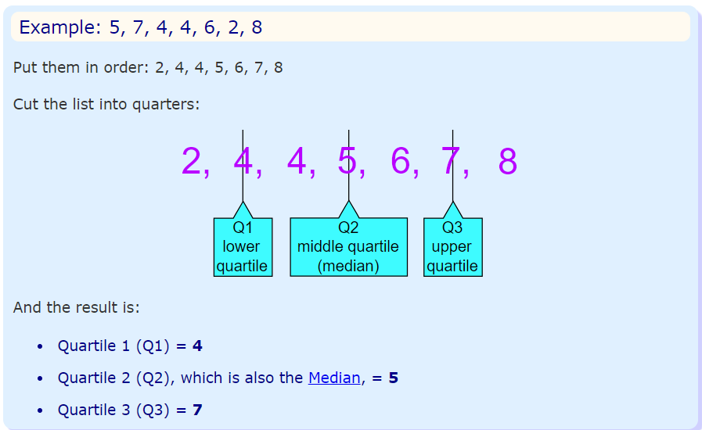
Quartiles
Quartiles are the values that divide a list of numbers into quarters:
Put the list of numbers in order
Then cut the list into four equal parts
The Quartiles are at the "cuts“

Slide 17
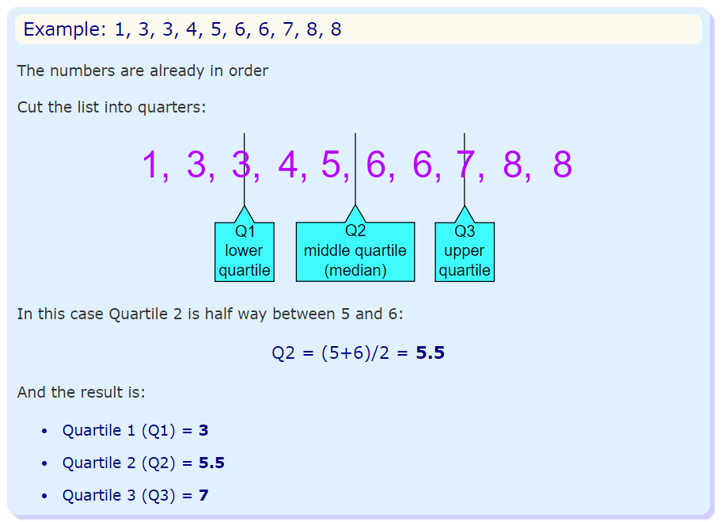
Quartiles

Slide 18
Normal Distribution
A normal distribution, sometimes called the bell curve, is a distribution that occurs naturally in many situations.
For example, the bell curve is seen in tests like the SAT and GRE.
The bulk of students will score the average (C), while smaller numbers of students will score a B or D.
An even smaller percentage of students score an F or an A.
This creates a distribution that resembles a bell (hence the nickname).
The bell curve is symmetrical. Half of the data will fall to the left of the mean; half will fall to the right.

Slide 19
Normal Distribution
Many groups follow this type of pattern. That’s why it’s widely used in business, statistics and in government bodies like the FDA:
Heights of people.
Measurement errors.
Blood pressure.
Points on a test.
IQ scores.
Salaries.

Slide 20
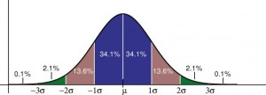
Normal Distribution
The empirical rule tells you what percentage of your data falls within a certain number of standard deviations from the mean: • 68% of the data falls within one standard deviation of the mean. • 95% of the data falls within two standard deviations of the mean. • 99.7% of the data falls within three standard deviations of the mean.

Slide 21
Normal Distribution
The standard deviation controls the spread of the distribution.
A smaller standard deviation indicates that the data is tightly clustered around the mean; the normal distribution will be taller.
A larger standard deviation indicates that the data is spread out around the mean; the normal distribution will be flatter and wider.

Slide 22
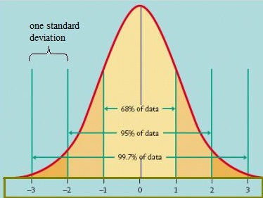
Standard Normal Model

Slide 23
Normal Distribution
Properties of a normal distribution
The mean, mode and median are all equal.
The curve is symmetric at the center (i.e. around the mean, μ).
Exactly half of the values are to the left of center and exactly half the values are to the right.
The total area under the curve is 1.

Slide 24
Word problems with normal distribution: “Between”: Steps
Step 1: Identify the parts of the word problem. The word problem will identify:
The mean (average or μ).
Standard deviation (σ).
Number selected (i.e. “choose one at random” or “select ten at random”).
X: the numbers associated with “between” (i.e. “between $5,000 and $10,000” would have X as 5,000 and as $10,000).

Slide 25
Word problems with normal distribution: “Between”: Steps
Step 1: Identify the parts of the word problem. The word problem will identify:
The mean (average or μ).
Standard deviation (σ).
Number selected (i.e. “choose one at random” or “select ten at random”).
X: the numbers associated with “between” (i.e. “between $5,000 and $10,000” would have X as 5,000 and as $10,000).

Slide 26
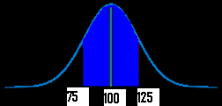
Word problems with normal distribution: “Between”: Steps
Step 2: Draw a graph. Put the mean you identified in Step 1 in the center.
Put the number associated with “between” on the graph (take a guess at where the numbers would fall–it doesn’t have to be exact).
For example, if your mean was $100, and you were asked for “hourly wages between $75 and $125”) your graph will look something like this:

Slide 27
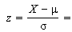
Word problems with normal distribution: “Between”: Steps
Step 3:Figure out the z-scores.
Plug the first X value (in my graph above, it’s 75) into the z value formula and solve. The μ (the mean), is 100 from the sample graph. You can get these figures (including σ, the standard deviation) from your answers in step 1 :
z score formula
*Note: if the formula confuses you, all this formula is asking you to do is:
subtract the mean from X
divide by the standard deviation.

Slide 28
Word problems with normal distribution: “Between”: Steps
Step 4: Repeat step 3 for the second X.
Step 5: Take the numbers from step 3 and 4 and use them to find the area in the z-table.
Step 6a:
Convert the answer from step 5 into a percentage.
For example, 0.1293 is 12.93%.
That’s it–skip step 6b!
Step 6b
Multiply the sample size (found in step 1) by the z-value you found in step 4. For example, 0.300 * 100 = 30.
That’s it!

Slide 29
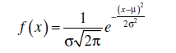
Normal Distribution
They are approximately symmetrical, and the mode is close to the centre of the distribution.
The mean, median, and mode are close together.
The shape of the distribution can be approximated by a bell: nearly flat on top, then decreasing more quickly, then decreasing more slowly toward the tails of the distribution.
This implies that values close to the mean are relatively frequent, and values farther from the mean tend to occur less frequently.
Probability Density Function

Slide 30
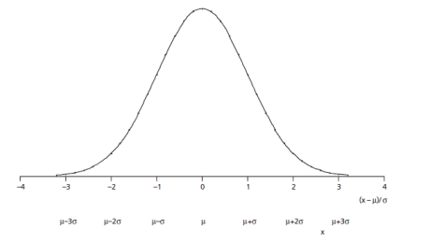
Normal Distribution

Slide 31
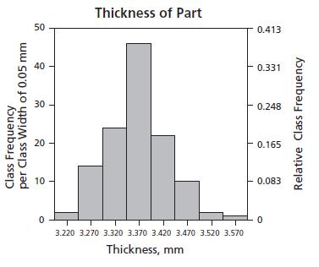
Normal Distribution

Slide 32
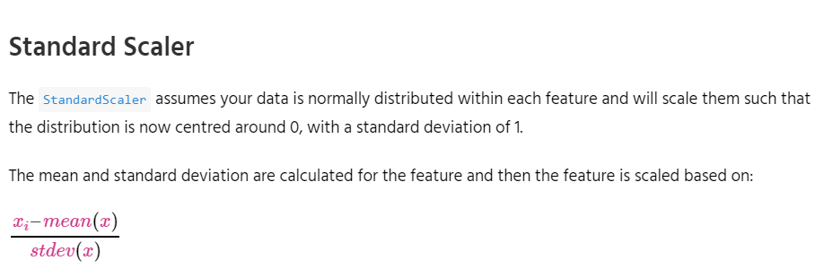
Feature Scaling
StandardScaler
MinMaxScaler
RobustScaler
Normalizer

Slide 33
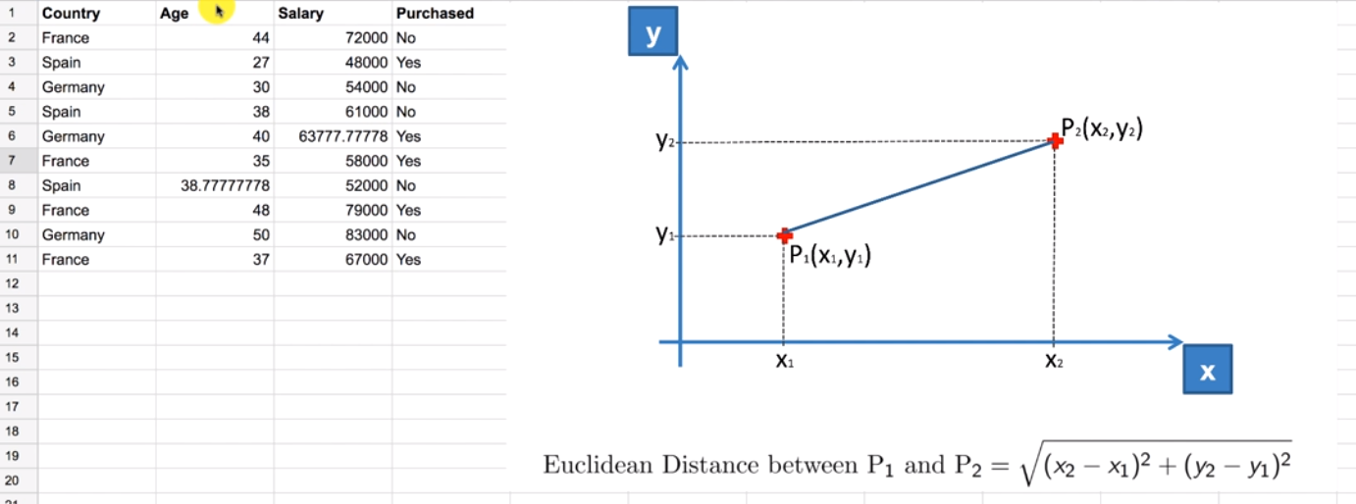

Slide 34
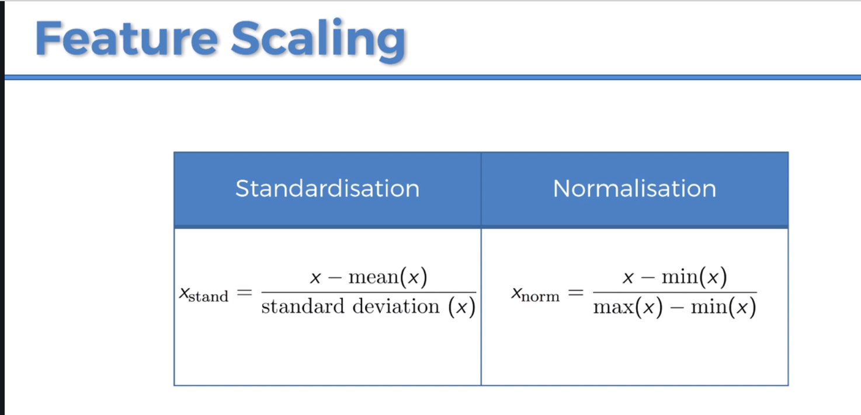

Slide 35
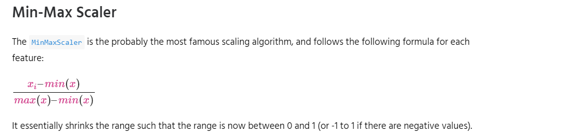
Feature Scaling
StandardScaler
MinMaxScaler
RobustScaler
Normalizer

Slide 36
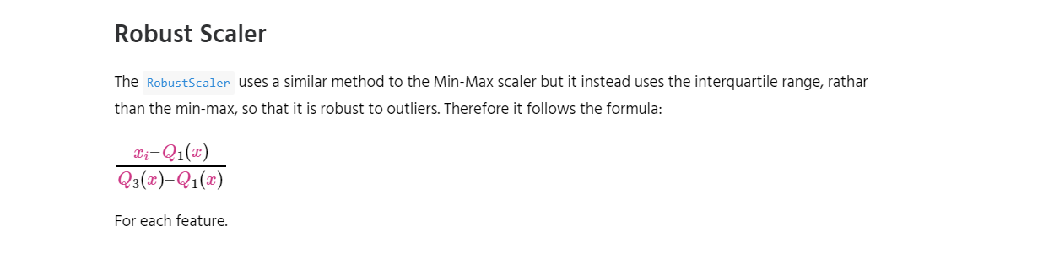
Feature Scaling

Slide 37
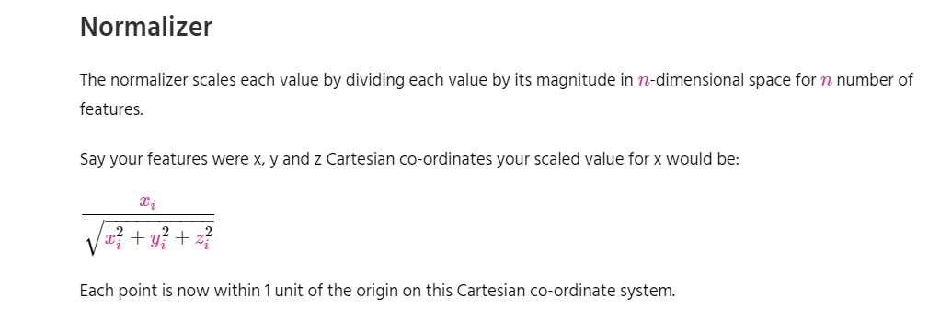
Feature Scaling

Slide 38
Simple Linear Regression
Simple linear regression is a statistical method that allows us to summarize and study relationships between two continuous (quantitative) variables:
One variable, denoted x, is regarded as the predictor, explanatory, or independent variable.
The other variable, denoted y, is regarded as the response, outcome, or dependent variable.

Slide 39
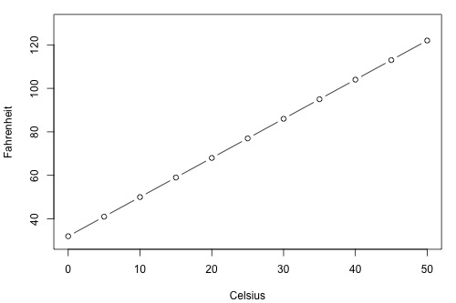
Simple Linear Regression

Slide 40
Types of Relationships
Deterministic
Temperature conversion
Circumference = π × diameter
Hooke's Law: Y = α + βX, where Y = amount of stretch in a spring, and X = applied weight.
Ohm's Law: I = V/r, where V = voltage applied, r = resistance, and I = current.
Boyle's Law: For a constant temperature, P = α/V, where P = pressure, α = constant for each gas, and V = volume of gas.

Slide 41
Types of Relationships
Statistical
Height and weight — as height increases, you'd expect weight to increase, but not perfectly.
Alcohol consumed and blood alcohol content — as alcohol consumption increases, you'd expect one's blood alcohol content to increase, but not perfectly.
Vital lung capacity and pack-years of smoking — as amount of smoking increases (as quantified by the number of pack-years of smoking), you'd expect lung function (as quantified by vital lung capacity) to decrease, but not perfectly.
Driving speed and gas mileage — as driving speed increases, you'd expect gas mileage to decrease, but not perfectly.

Slide 42
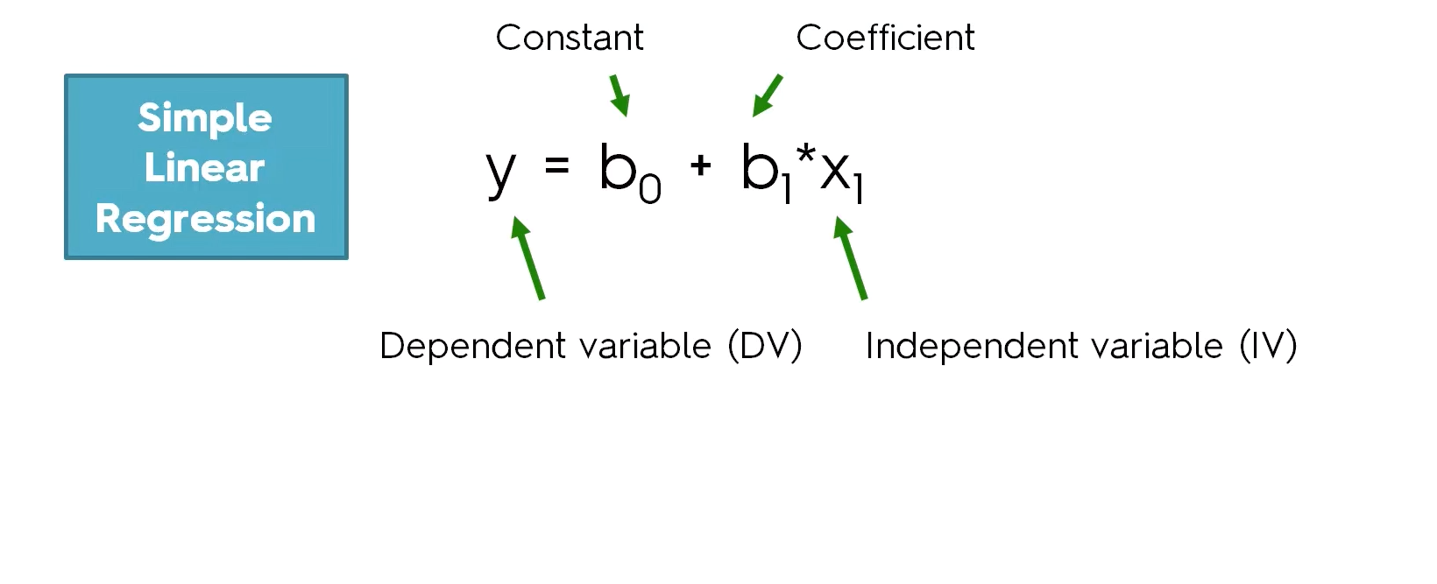

Slide 43
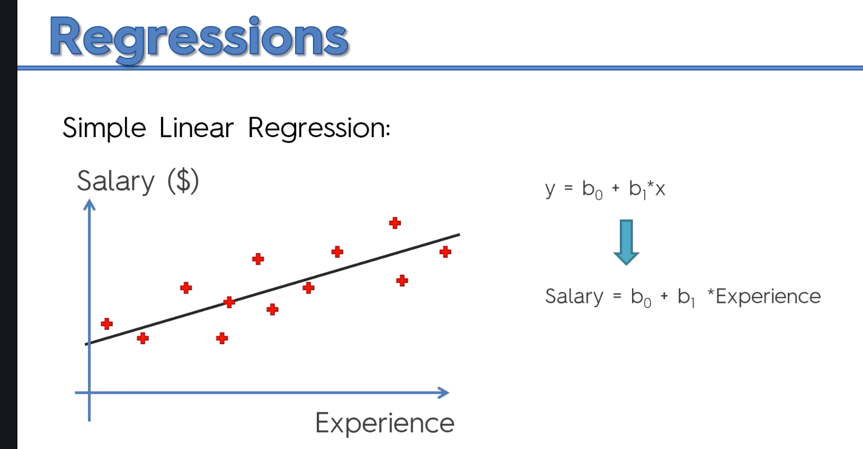

Slide 44
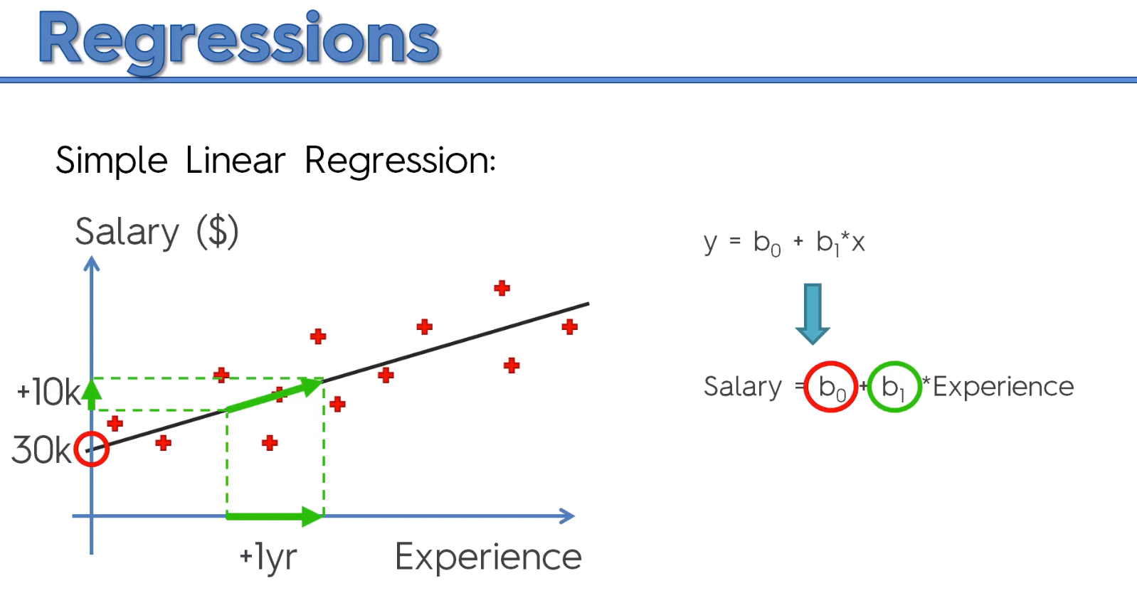

Slide 45
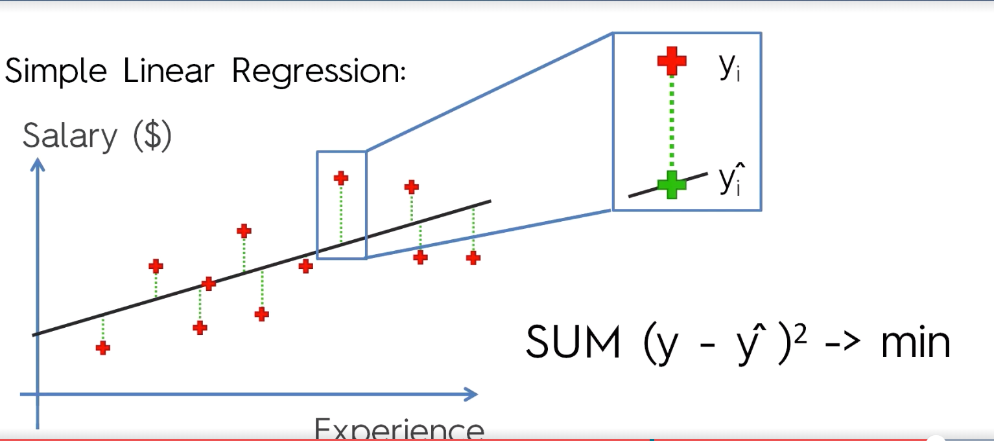
Ordinary Least Square Method

Slide 46
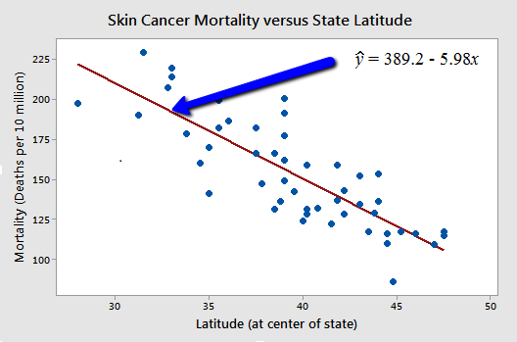
Types of Relationships

Slide 47
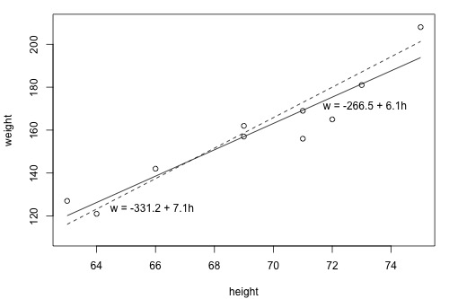
What is the "Best Fitting Line"?

Slide 48
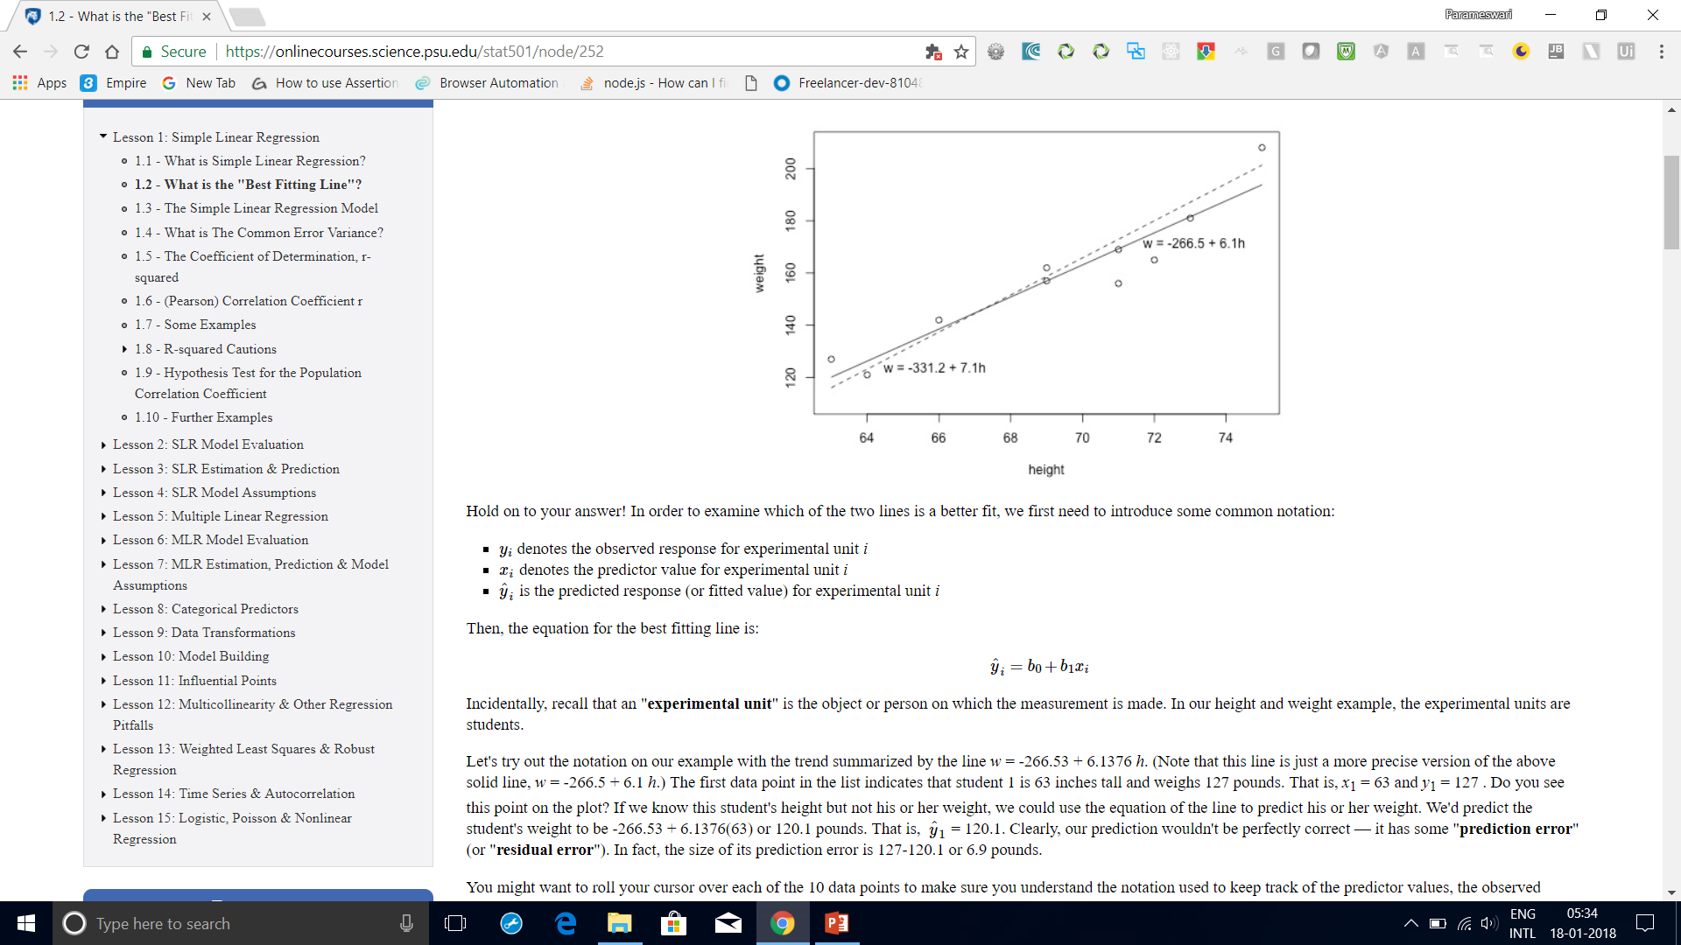
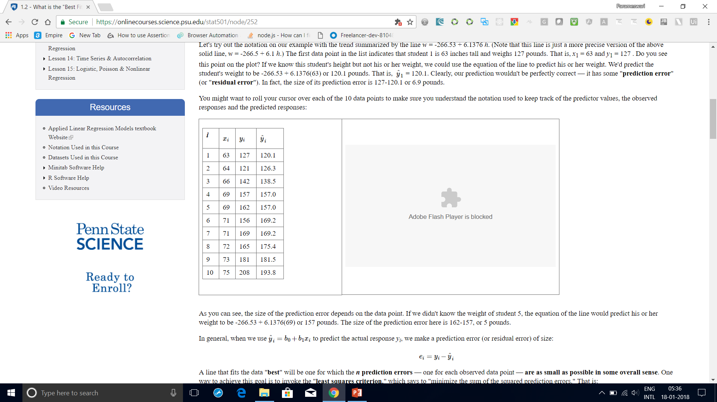
What is the "Best Fitting Line"?
it has some "prediction error" (or "residual error").
In fact, the size of its prediction error is 127-120.1 or 6.9 pounds.
As you can see, the size of the prediction error depends on the data point.
If we didn't know the weight of student 5, the equation of the line would predict his or
her weight to be -266.53 + 6.1376(69) or 157 pounds.
The size of the prediction error here is 162-157, or 5 pounds.

Slide 49
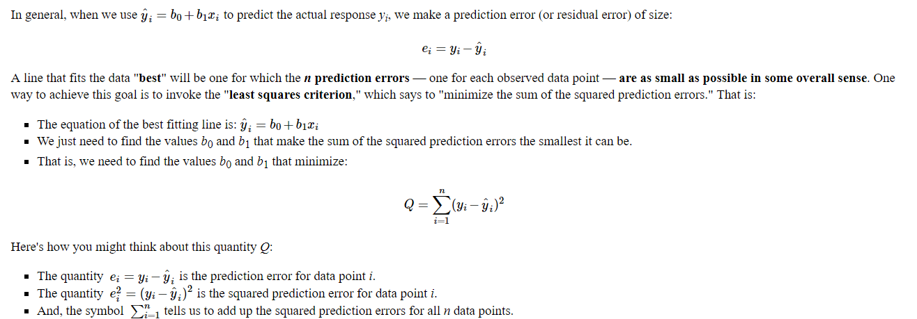
What is the "Best Fitting Line"?

Slide 50
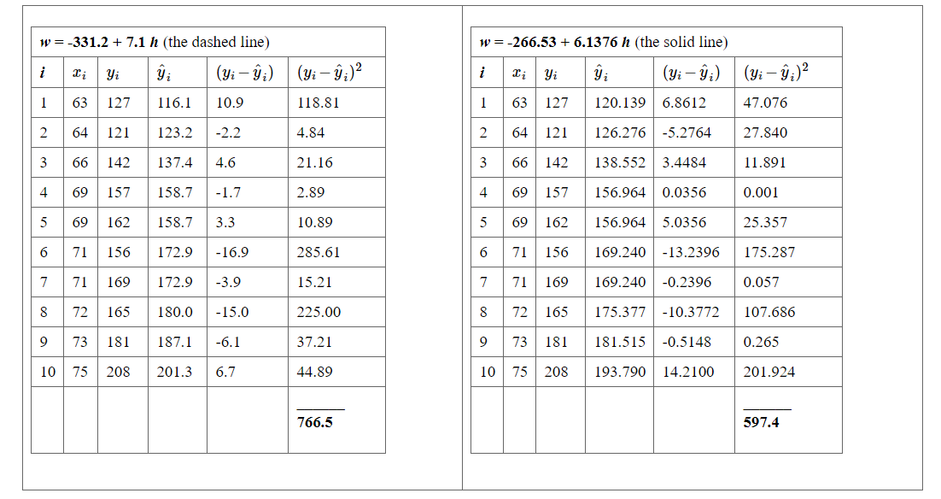
What is the "Best Fitting Line"?

Slide 51
What is the "Best Fitting Line"?
Based on the least squares criterion, which equation best summarizes the data?
The sum of the squared prediction errors is 766.5 for the dashed line, while it is only 597.4 for the solid line.
Therefore, of the two lines, the solid line, w = -266.53 + 6.1376h, best summarizes the data.

Slide 52
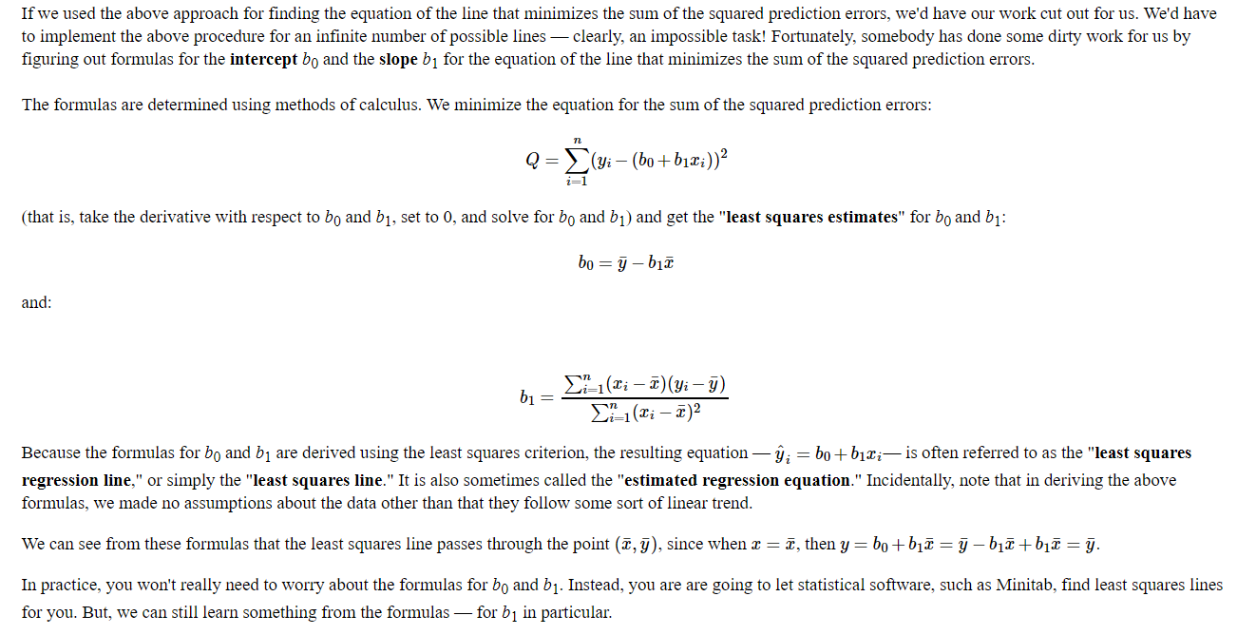
What is the "Best Fitting Line"?

Slide 53
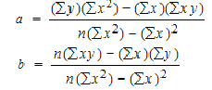
Slope and Intercept calculation

Slide 54
How to Find a Linear Regression Equation: Steps
Step 1: Make a chart of your data, filling in the columns in the same way as you would fill in the chart if you were finding the Pearson’s Correlation Coefficient.
SUBJECT | AGE X | GLUCOSE LEVEL Y | XY | X² | Y²
1 | 43 | 99 | 4257 | 1849 | 9801
2 | 21 | 65 | 1365 | 441 | 4225
3 | 25 | 79 | 1975 | 625 | 6241
4 | 42 | 75 | 3150 | 1764 | 5625
5 | 57 | 87 | 4959 | 3249 | 7569
6 | 59 | 81 | 4779 | 3481 | 6561
Σ | 247 | 486 | 20485 | 11409 | 40022
From the above table, Σx = 247, Σy = 486, Σxy = 20485, Σx2 = 11409, Σy2 = 40022. n is the sample size (6, in our case).

Slide 55
How to Find a Linear Regression Equation: Steps
Step 2: Use the following equations to find a and b.
a = 65.1416 b = .385225

Slide 56
How to Find a Linear Regression Equation: Steps
Step 2: Use the following equations to find a and b.
Find a:
((486 × 11,409) – ((247 × 20,485)) / 6 (11,409) – 247²)
484979 / 7445
=65.14
Find b:
(6(20,485) – (247 × 486)) / (6 (11409) – 247²)
(122,910 – 120,042) / 68,454 – 247²
2,868 / 7,445
= .385225

Slide 57
How to Find a Linear Regression Equation: Steps
Step 3: Insert the values into the equation. y’ = a + bx y’ = 65.14 + .385225x
That’s how to find a linear regression equation by hand!

Slide 58
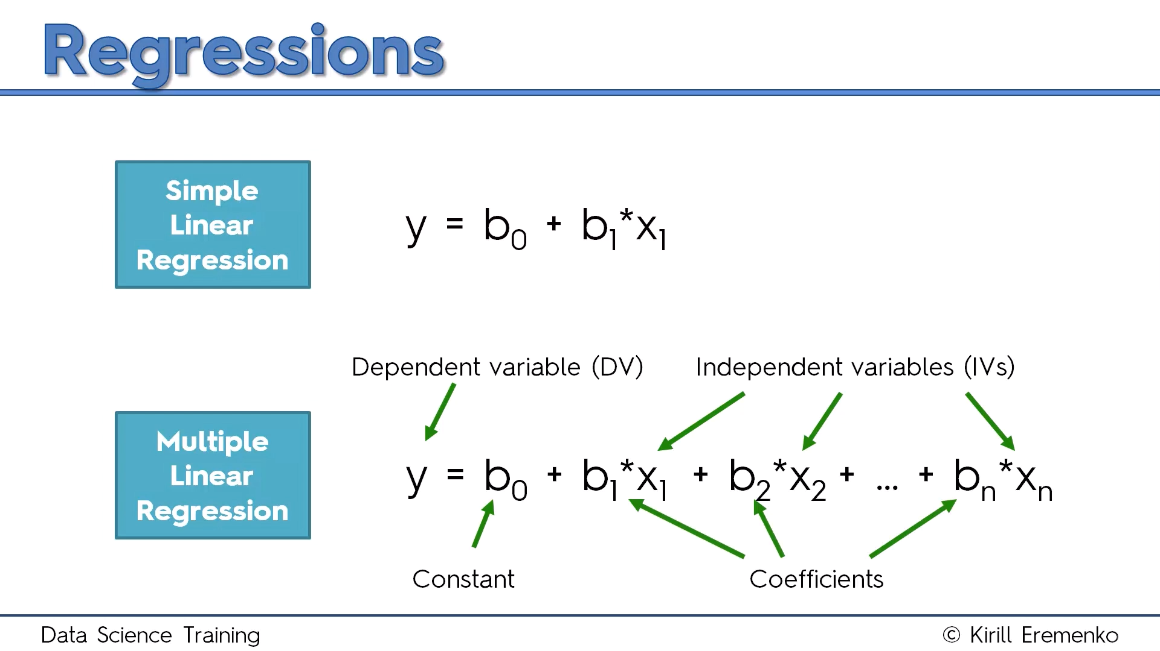
Multiple Linear Regression

Slide 59
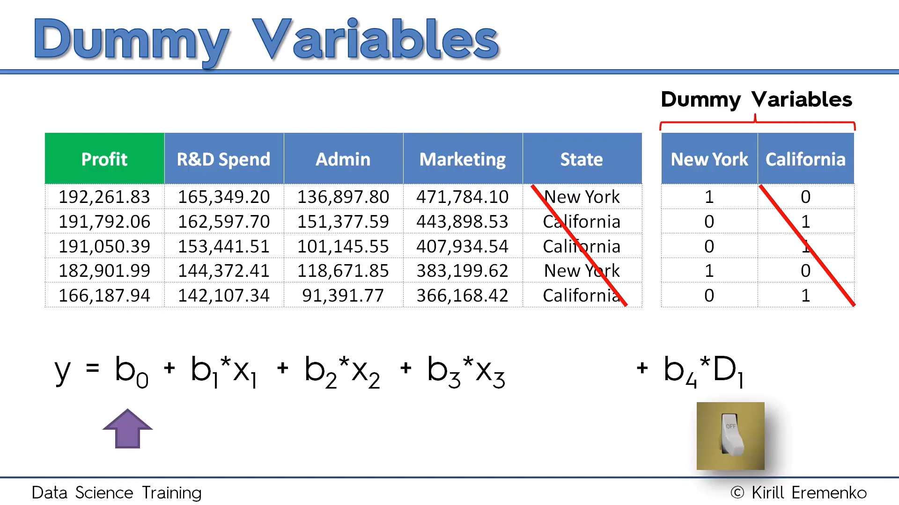

Slide 60
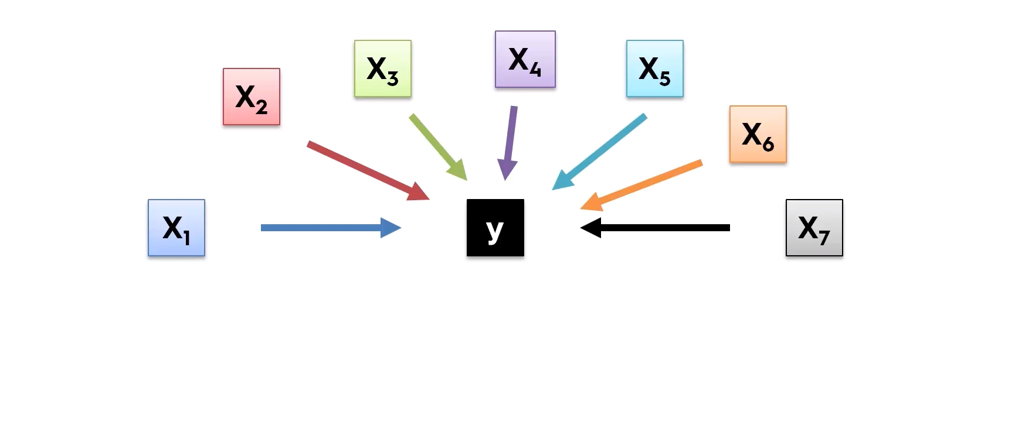
Building Model

Slide 61
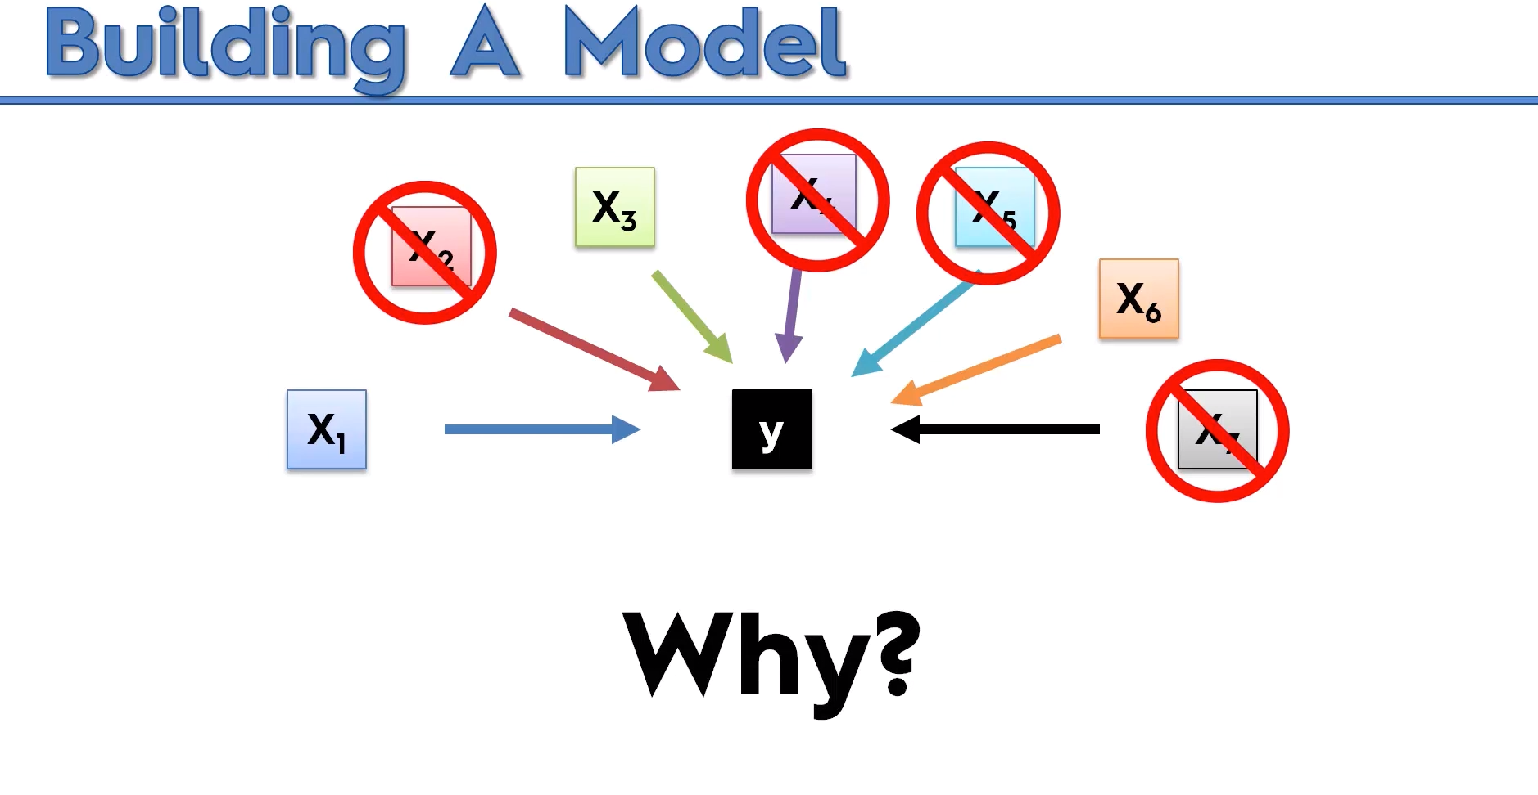

Slide 62
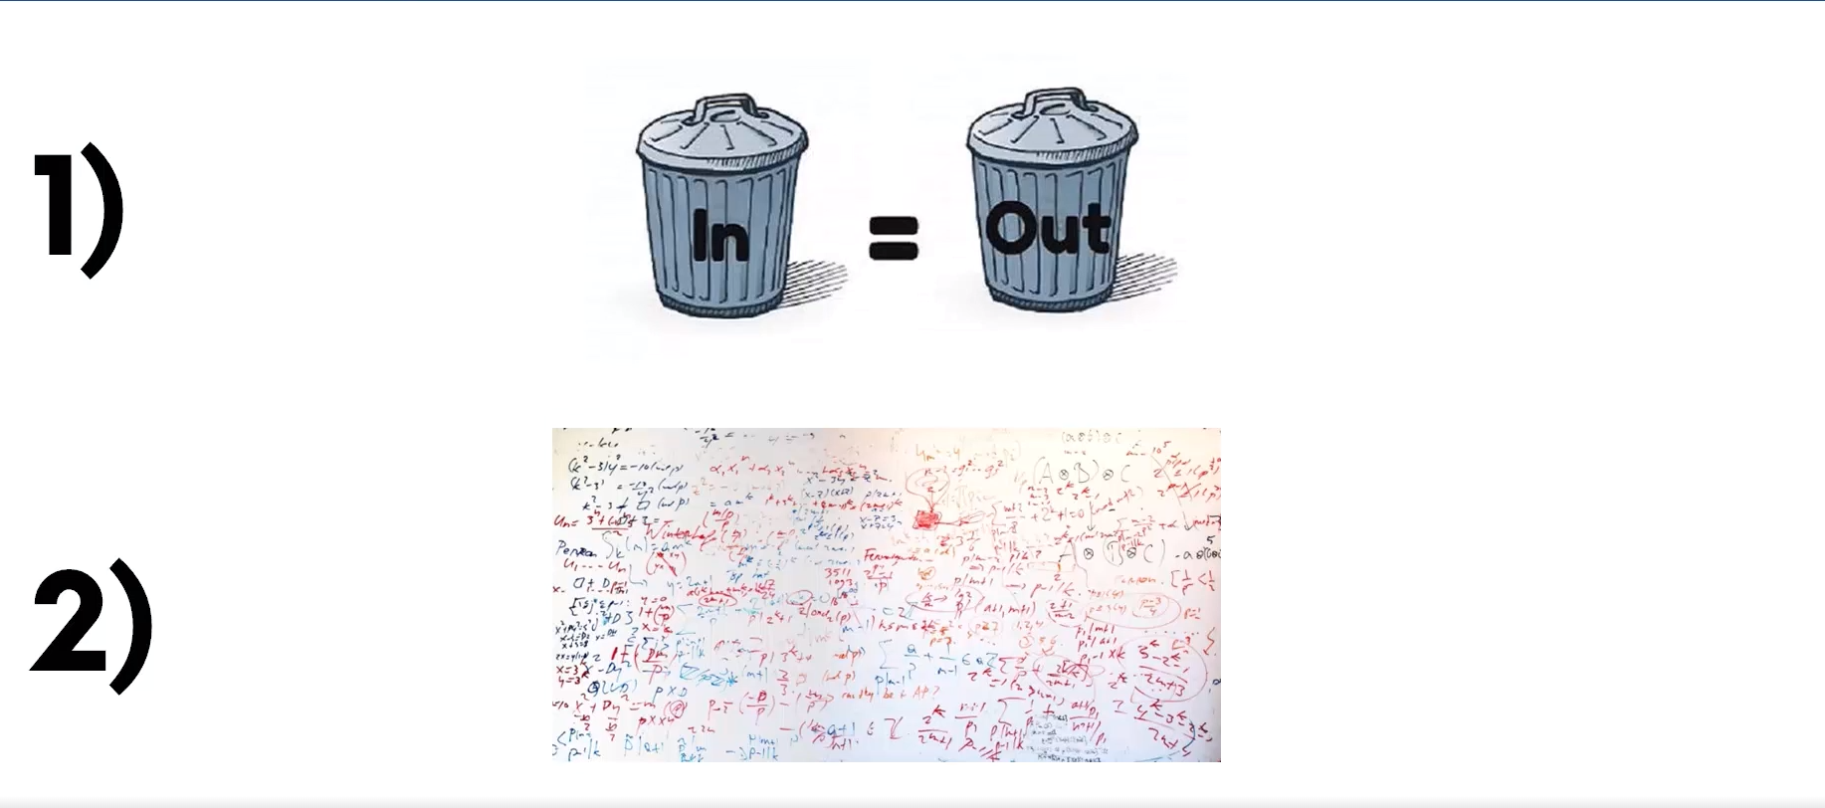

Slide 63
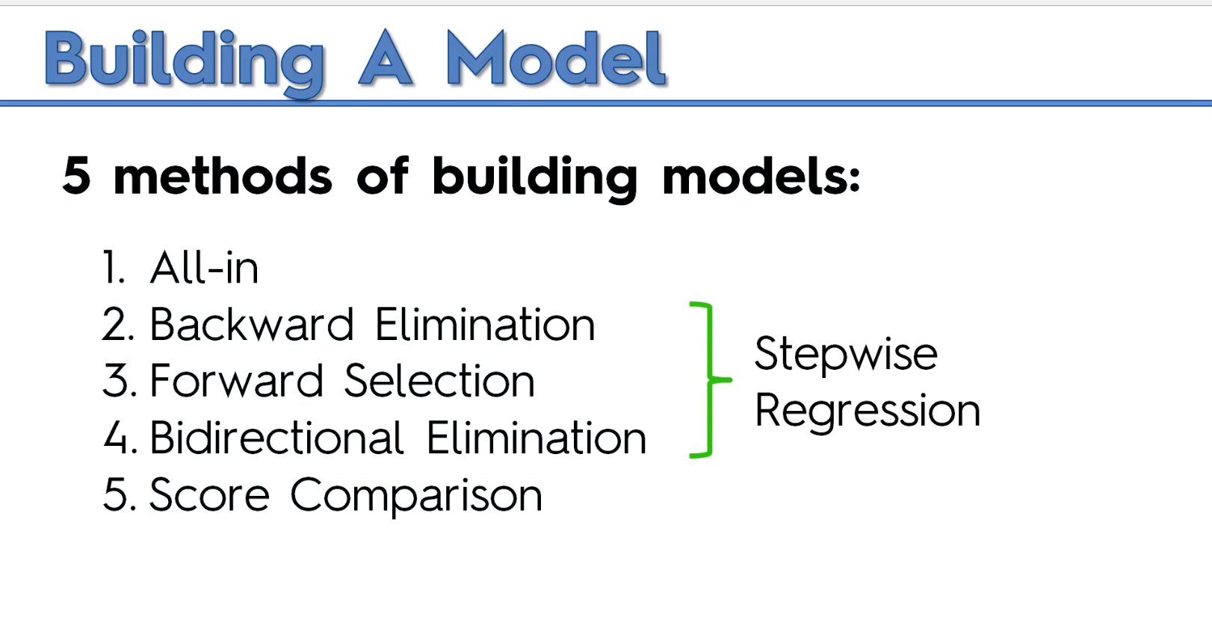

Slide 64
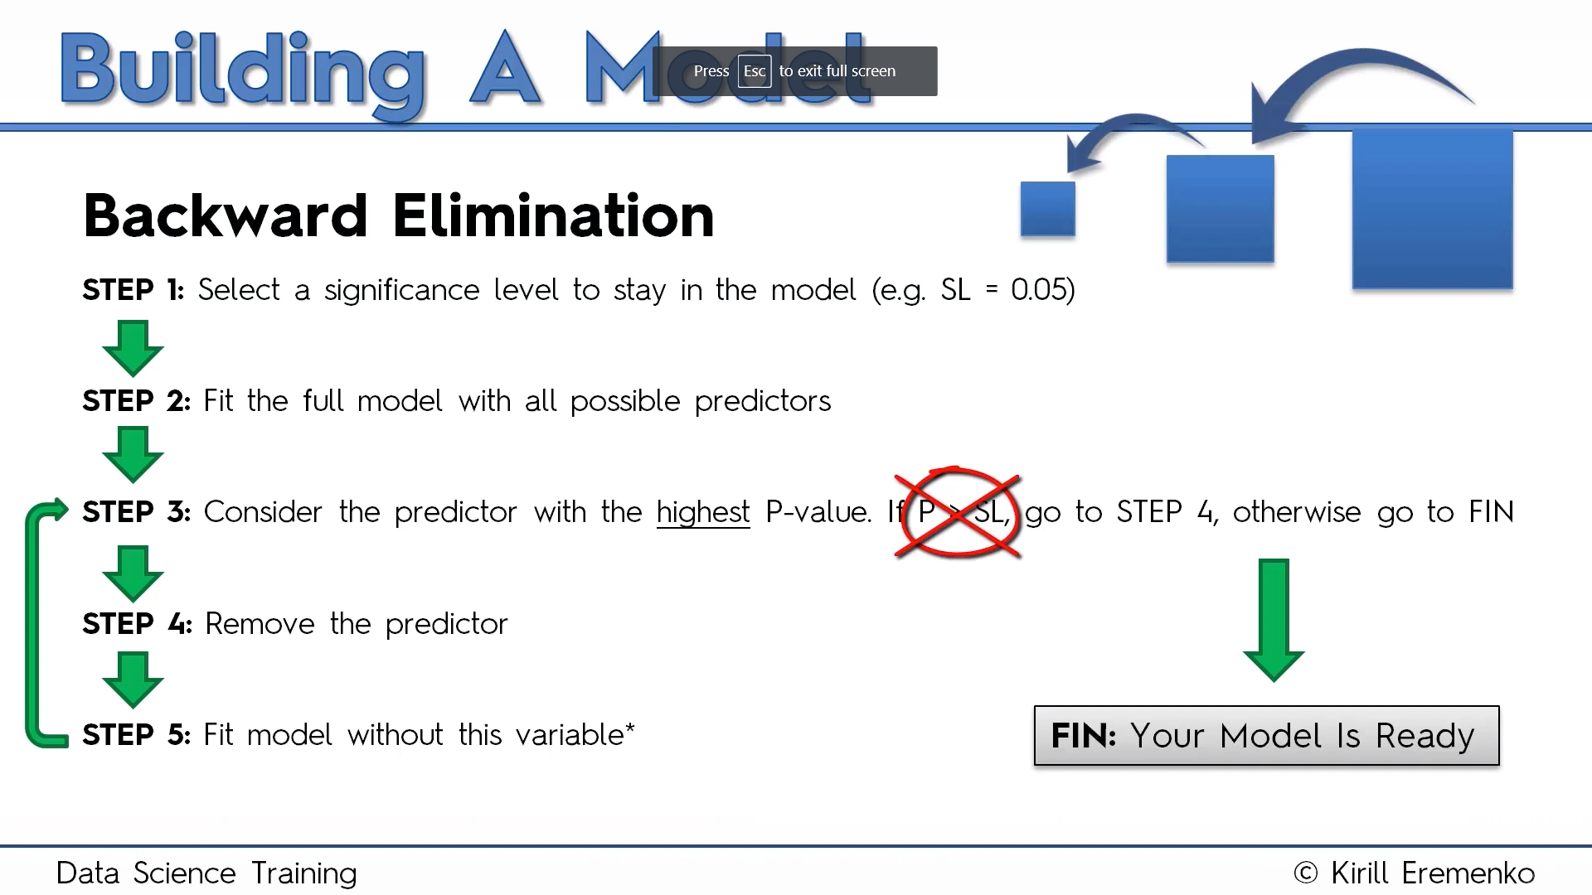

Slide 65
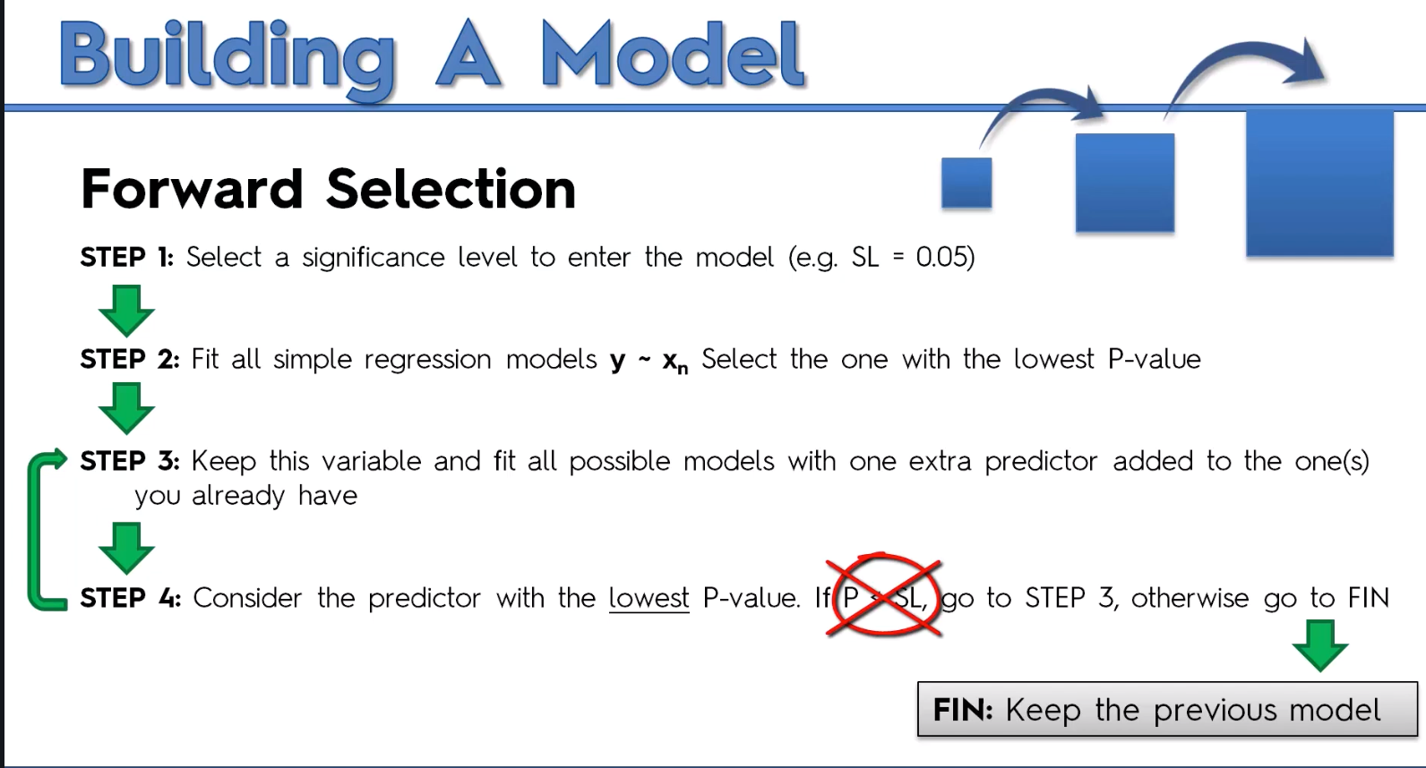

Slide 66
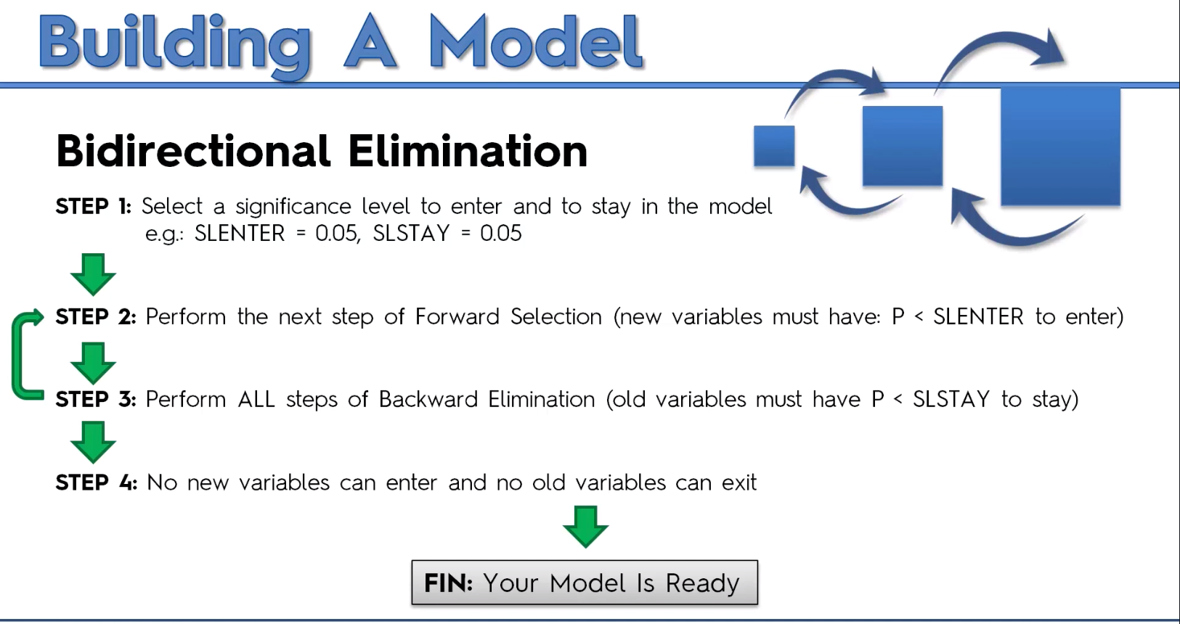

Slide 67
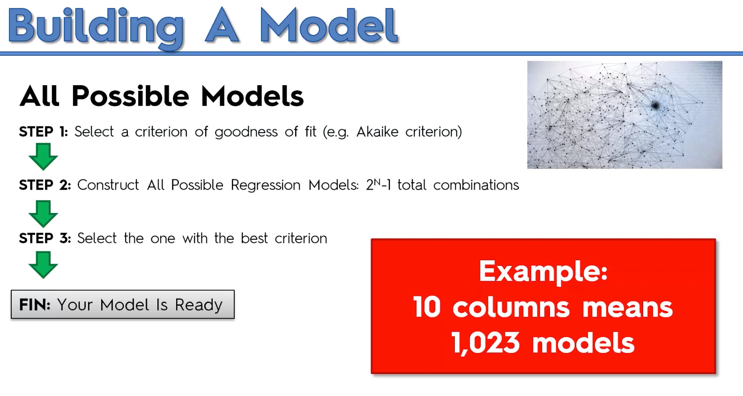

Slide 68
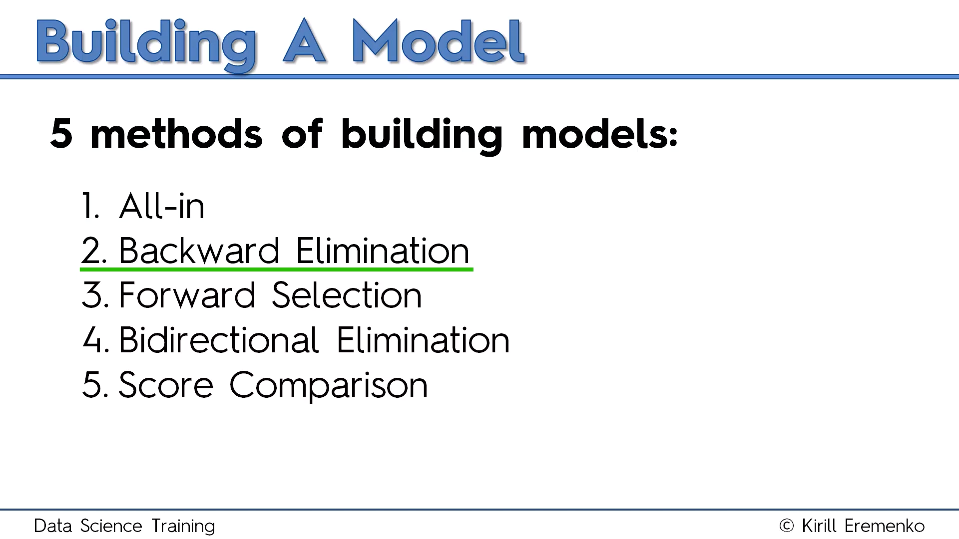

Slide 69
import statsmodels.formula.api as sm
def backwardElimination(x, sl):
numVars = len(x[0])
for i in range(0, numVars):
regressor_OLS = sm.OLS(y, x).fit()
maxVar = max(regressor_OLS.pvalues).astype(float)
if maxVar > sl:
for j in range(0, numVars - i):
if (regressor_OLS.pvalues[j].astype(float) == maxVar):
x = np.delete(x, j, 1)
regressor_OLS.summary()
return x
SL = 0.05
X_opt = X[:, [0, 1, 2, 3, 4, 5]]
X_Modeled = backwardElimination(X_opt, SL)

Slide 70
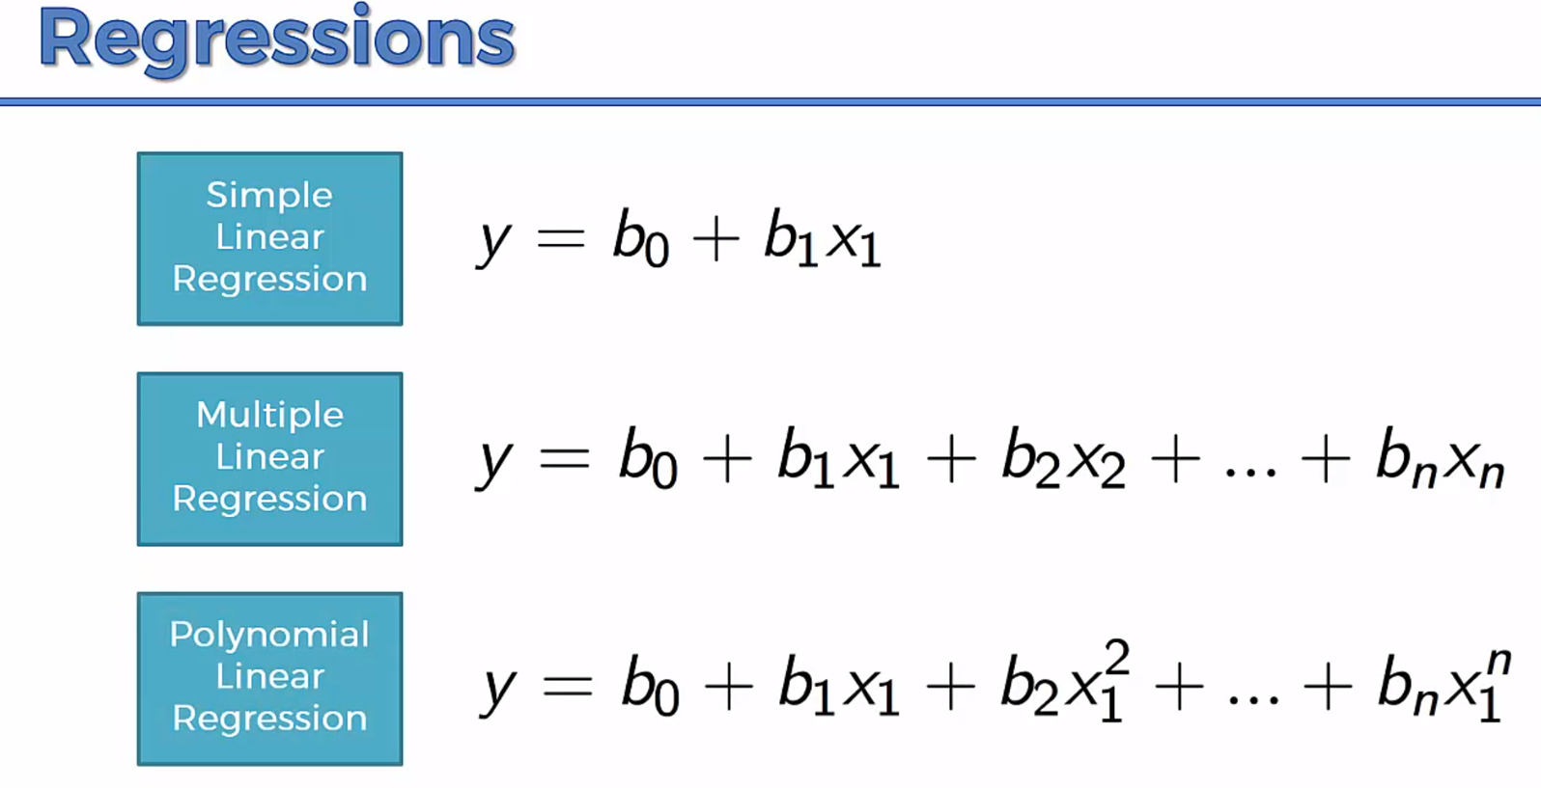

Slide 71


Slide 72

Decision Tree Regression

Slide 73

Decision Tree Regression

